Slide 1
ThingWorx in acatech industry 4.0 maturity journey
Andrew Sholokhov
VP, Country General Manager PTC Russia & CIS
June 20, 2017
Notes:
This presentation is an introduction to the ThingWorx Foundation IoT Platform. ThingWorx is the only enterprise-ready IoT technology platform that enables innovators to rapidly develop and deploy smart, connected solutions for the Internet of Things. This presentation will look over the base component of the platform and provide information on how it fits together with the other TPG components in an effort to provide innovators with the quickest path of development for IoT solutions.

Slide 2
ThingWorx in acatech industry 4.0 maturity journey
PLM & IoT: Windchill & ThingWorx
Industry 4.0 Maturity Index by acatech
Maturity Step 2: Connectivity
Maturity Step 3: Visibility
Maturity Step 4: Transparency
Maturity Step 5: Predictability
Maturity Step 6: Adaptability

Slide 3
PTC is the only company to lead both in PLM and IOT

Slide 4
PLM: 5 main product development tasks
YOUR GOAL: FASTER TIME TO MARKET
First-mover or fast-follower INNOVATION
Reduce product and process COMPLEXITY
Ensure quality and COMPLIANCE
Manage time and resource
COST
Notes:
These challenges, however, can be overcome allowing product development companies to
Achieve first-mover or fast-follower advantage through AGILITY and SPEED
Ensure compliance through HIGH-QUALITY innovations
Manage product complexity by FRICTIONLESS COLLABORATION.
Delivering quickly, on time / on budget, and effectively handling product complexities all reduce costs, while maintaining first-mover or fast-follower levels of innovation boosts profitability!

Slide 5
PROVEN transformation With Windchill
INNOVATION & COMPLIANCE
COMPLEXITY & COST
80% improvement in design and process reuse
20-30% increase in productivity
Cycle-time reduction 8% to 35%
Reduced release management process 75% Reduced preferred parts list 30%
Reduced time to design new products by 87% and time to design variants (via reuse) by 55%
Parts count reduced by 12%
Reduced ETO process by weeks Millions of dollars saved annually
Increased efficiency of global collaboration 300%
40% reduction in platforms, 35% reduction in components, 10-20% reduction in costs
First-Pass Yield Improved 20-30% over 4 years
Notes:
PTC Windchill has a proven track record of enabling the best companies in the world to drive innovation, quality and compliance while managing complexity and driving down cost.

Slide 6
PROVEN Transformation With windchill
INNOVATION & COMPLIANCE
COMPLEXITY & COST
10-20% more productivity
Reduced cost of compliance by 80%
>50% reduction in release cycle, concept design to production
Development lead-time reduced by 30% > 90% of technical problems solved during design
Find and reload data 50% faster Reduce time to production by 2X
122% Annual ROI; Shortened design time 40-60%
Delivers products 300% Faster: from concept to production in 18 months
128% Annual ROI; 1-2 hours per week increased engineer productivity
Design of new iterations reduced from 2 weeks to 5 minutes
Notes:
Visit www.ptc.com where many of our customers have been proud to share case studies of how PTC Windchill is helping them to win.

Slide 7
ThingWorx Platform
INDUSTRIAL CONNECTIVITY
FOUNDATION
ANALYTICS
UTILITIES
ThingWorx Studio
ThingWorx Apps
THINGWORX NAVIGATE
THINGWORX CONTROLS ADVISOR
THINGWORX PRODUCTION ADVISOR
PLATFORM + APPS + SUPPORTING SERVICES
THINGWORX ASSET ADVISOR
ThingWorx Developer Zone
ThingWorx Marketplace
Notes:
ThingWorx is the fastest way for industrial companies to unlock the value of physical digital convergence.
The ThingWorx platform, now at its 8th release, has grown alongside the Internet of Things (IoT) providing industry with new ways to operate and compete. ThingWorx has become the go-to way for enterprises to leverage the IoT to create smart connected operations, products and solutions.
Today, ThingWorx leadership is evident in its educational offerings; its marketplace of compatible products and extensions; its comprehensive services; its massive ecosystem of customers, partners and others; its developer portal; and its purpose-built Industrial IoT platform and role-specific apps built on that platform.
The ThingWorx platform includes compatible modules that deliver the functionality, flexibility and agility you need to quickly develop and deploy industrial IoT apps and game-changing augmented reality (AR) experiences. This includes industrial connectivity, analytics, application enablement, orchestration and AR authoring.
ThingWorx, everything you need to make the Internet of Things work for your business.

Slide 8
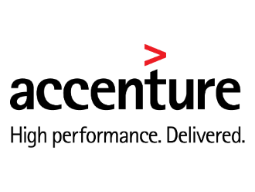
ThingWorx STUDIO CUSTOMER Program
2,000+
Participating Companies
STUDIO.ThingWorx.com

Slide 9
Analyst Reviews
CLEAR MARKET LEADER
WITH 18% MARKET SHARE
CLEAR MARKET LEADER
FOR IoT TECHNOLOGY PLATFORMS
CLEAR MARKET LEADER
IN AUGMENTED REALITY
CLEAR MARKET LEADER
IoT PLATFORM MARKET
CLEAR MARKET LEADER
INDUSTRIE 4.0 IoT VENDOR BENCHMARK 2016
PTC 18%
PTC 27%
VUFORIA 81%
5
Investigate
Engage
100%
Product Challenger
Leader
100%
Other
10%
ThingWorx
PTC
Other
49%
Other
36%
Portfolio Attractiveness
3
50%
50%
Total market size 2015: $298M
Total market size 2015: $221M
Technology Strength
1
1
Watch for improvement
3
Monitor
5
0%
Follower
50%
Market Challenger
0%
100%
Product Maturity
Competitive Strength
Source: IoT Analytics
Source: BCC Research
Source: Aeon Mobile
Source: Lux Research, Inc.
Source: Experton Market Insight
Notes:
We don’t just think we have the market leading platform, the analysts are stating it emphatically.
IoT Analytics is the leading provider of market insights for the Internet of Things (IoT), M2M, and Industry 4.0. More than 20,000 IoT decision makers now rely on our data-driven market research every month. Our products and services portfolio includes free insights on IoT markets and companies, focused market reports on specific IoT segments and Go-to-Market services for emerging IoT companies.
http://iot-analytics.com
Experton Group is the leading fully integrated research, advisory and consulting company for mid-sized and large organizations, maximizing the business value of their ICT investments through innovative, neutral and independent expert advice.
http://www.experton-group.com/home.html
BCC Research is a leading market research company covering changes driven by science and technology for over 40 years. Our market research coverage provides detailed market size forecasts that incorporate the major economic, scientific, and technological developments in industrial, pharmaceutical, and high technology organizations. Industry analysis and market forecasts for advanced materials, high-tech systems and components, nanotechnology and novel processing methods are at the forefront of the company's expertise. http://www.bccresearch.com

Slide 10
Industry 4.0 Maturity Index by acatech

Slide 11
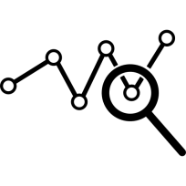
Acatech Industry 4.0 Maturity Journey
How can autonomous reaction take place?
Industrie 4.0
“Self-optimizing”
6
What will happen?
“Being prepared”
Industrie 4.0 Maturity Index
Business Value
Why does it happen?
5
“Understanding”
What does happen?
“Seeing”
4
3
2
1
Computerization
Connectivity
Visibility
Transparency
Predictability
Adaptability
Industrie 3.0
Industrie 4.0
Development Path

Slide 12
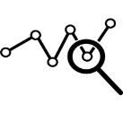
Four Spheres of the Company Industry 4.0 journey
Resources
Information Systems
From inside out: Six levels characterize the Industrie 4.0 maturity
1
Tasks are supported by data processing systems Employees are relieved from repetitive manual activities.
6
Adaptability
5
Predictability
2
4
Data processing systems are structured and linked Core business processes are reflected in IT Systems
<<<<<
Transparency
3
Visibility
<
3
2
Connectivity
Companies have a digital shadow The management takes data-based decisions.
1
Computerization
4
Companies understand why events happen Knowledge is discovered through recognition
5
Companies know what will happen in the future. Decisions are made on the basis of future scenarios.
6
Companies react autonomously on conditions. The system controls itself autonomously and is fully viable
Organizational Structure
Culture

Slide 13
Industry 4.0 MATURITY STEP 2: CONNECTIVITY
Resources
Information Systems
<<<<<
<
2
Connectivity
Organizational Structure
Culture

Slide 14
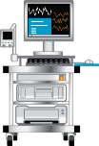
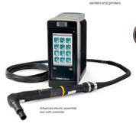
ThingWorx Supports any Connectivity Scenario
Edge
DEVICE MANAGEMENT
SDKs and IoT Gateway
Edge Intelligence
Data Drivers
Bi-directional Communication
Securely connect to nearly any device over any network via wired, wireless or cellular methods
Out-of-the-box connectivity via data drivers with ThingWorx and Kepware
Continuous bi-directional connectivity between sensors, devices, equipment, and the ThingWorx server
Enables distributed, real-time edge computing capabilities with an edge ‘solution stack’ eliminating potential issues with latency, cost, and security
Cloud, On-Premise, or Hybrid
ThingWorx Edge SDK (C, .Net, Java, IOS, Android
Edge MicroServer (EMS)
Gateway to multiple devices
Emerging Standards (MQTT protocols) or REST API
Proprietary Protocol
Notes:
Future proofing for scale and growth.
ThingWorx enables companies to securely connect to nearly any device using our SDKs, Edge MicroServer, or by leveraging standard and proprietary communication protocols. Devices can connect over any network via wired, wireless or cellular methods.
ThingWorx and Kepware each deliver data drivers to enable out-of-the-box connectivity with a wide variety of devices. Note: Kepware KEPServerEx offers a library of over 150 protocols adapters to access real-time data from industrial equipment.
ThingWorx “AlwaysOn” connectivity, via ThingWorx SDKs and the Edge MicroServer, provides a scalable, secure, and easily deployable communication technology designed for continuous bi-directional connectivity between sensors, devices, equipment, and the ThingWorx server - regardless of the network architecture
ThingWorx enables distributed, real-time edge computing capabilities with an edge ‘solution stack’ that collects and aggregates data from sensors, performs highly automated machine learning and executes business logic. Keeping the entire IoT computing operation onsite or close to the point of data acquisition can address potential latency, cost and security concerns associated with reliance on cloud only solutions.
Edge MicroServer
Prebuilt “agent” application that can “drop in and run” in a Windows or Linux environment
Can run on a gateway or be directly embedded into a device
Software Development Kits (SDK)
Software libraries that allow customers to create their own custom agent
Several platforms/programming languages available – Java, C, .NET, iOS
Can be deployed in gateways or devices

Slide 15
Any Cloud and Hybrid Deployment Support
Device Cloud
ptc: in cloud or on-premise
3rd party cloud providers
DEVICE MANAGEMENT
Identity and Access Management
Device and Cloud Adapters
Big Data and
Rules Engine
File Transfer, Messaging, Tunneling
Works seamlessly on premise and in public or private clouds
Open Platform strategy allows you to fully leverage existing cloud or device connectivity investments
Scale to millions of connected devices with hundreds of thousands of transactions per second
Provide complete connectivity including bi-directional messaging, file transfer, and application tunneling to a device
In Cloud or On-Premise
Any Device Cloud
Notes:
The thingworx platform is the most open and extensible IoT Platform on the market.
But recently, we have heard from the field that Amazon, Microsoft and other device cloud vendors have been aggressively pursuing our customers, especially our axeda base.
The good news is that the ThingWorx openness of the platform has always been ready to connect to other devices clouds. The better news is that we have partnership discussions with Amazon and Microsoft to formalize a productized integration point.
The result is that you can talk about any device cloud but stress the ease with which we will connect to AWS, Azure or Predix.
Enterprises to more fully leverage their cloud investments as well as mix and match their preferred combination of world-class components from a range of cloud providers and ThingWorx. Device Cloud Adapters offer scalable, secure connectivity and native ThingWorx modeling devices connected through device clouds.
ThingWorx DataStax Enterprise powered by Apache Cassandra delivers a data store purpose built for the performance and availability demands of IoT, web and mobile applications. The modern architecture enables customers to scale to millions connected devices with hundreds of thousands of transactions per second.
True connectivity is really about more than just getting data. More advanced capabilities are often needed. For example secure, bi-directional file transfer, application tunneling to a device, as well as the ability to stream video. ThingWorx can enhance any device cloud with the capabilities.
The ThingWorx Platform was built from the ground up with security in mind. ThingWorx leverages PKI infrastructure for certificate validation and has an extremely granular security model to enable data isolation and service execution.

Slide 16
Kepware for Industrial connectivity
Bridging the gap between diverse hardware and software applications.
Provides a fast-to-value connectivity option that can help kick-start smart, connected initiatives
Consolidates data and information from many sources into one connectivity platform
Offers connectivity to hundreds of types of automation controllers with 150 different drivers
Reduces network traffic and decreases device and system resource usage
Communication Platform
Industrial Connectivity
Data Exchanges

Slide 17
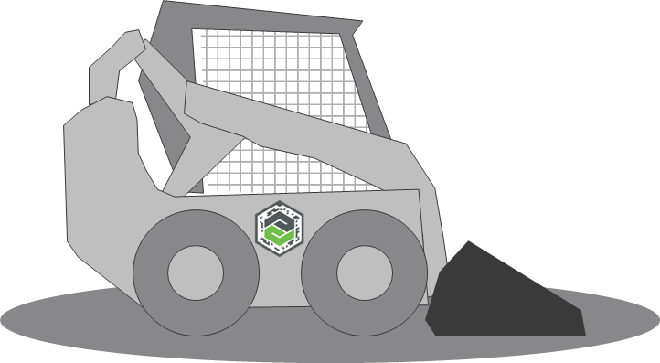
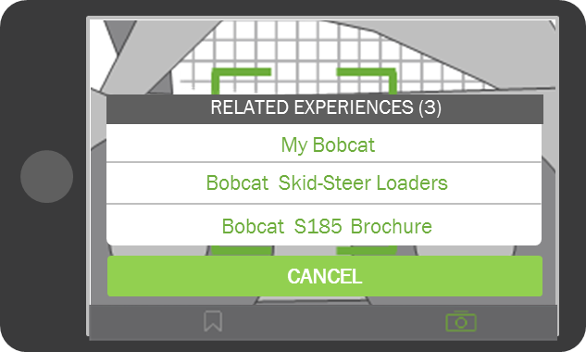
ThingMark
Unique Identifier
Quickly identifies the unique thing and its relevant experiences
Real World Alignment
Aligns 3D information contextually and spatially
Ability to Scale
Tracking vast numbers of products, dynamically updated in the Cloud

Slide 18
Industry 4.0 MATURITY STEP 3: VISIBILITY
Resources
Information Systems
<<<<<
3
Visibility
<
Organizational Structure
Culture

Slide 19
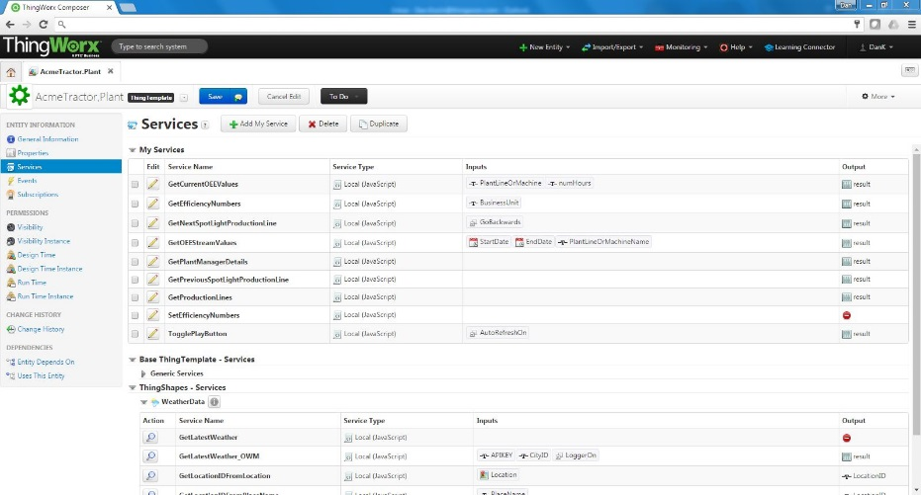
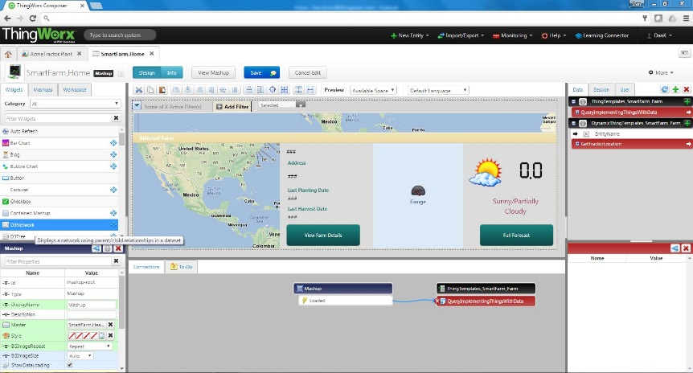
Rapid creation of enterprise ready applications
Application Enablement
Visual Application Modeling Environment
System Integration Services
User Interface Builder
Reporting and Basic Analytics
Business Logic and Event Processing
Identity and Access Management
thing
IoT Data Management
Extensible Design
model
API
Visual Application Modelling & “Drag & Drop” UI Builder
Visually model the your Things to increase development velocity, ease of maintenance and reusability of solutions
Leverage thousands of pre-built services to enable rapid application development and runtime application support.
Easily store, search, correlate and analyze unstructured data from people, structured data form systems, and time-series data from things.
Build rich interactive applications, dashboards, collaborative workspaces, and mobile interfaces without the need for coding
Deliver extremely secure solutions with a granular security model that enables data isolation and service execution
Create enterprise-ready applications with federation, high availability, and massive scale that can be deployed anywhere
Notes:
Create your own services leveraging code snippets or install community built functions, UI widgets, and integration services.
Things are equal actors in your solution, providing them the same ease of use and security models as traditional user, groups and organizations.
Future proofing for scale and growth.
The Model enables you to Enjoy ThingWorx drag-and-drop visual design experience for Web, Mobile, and Augmented Reality UX, without needing to be experts in those technologies. Using our “drag and drop” tools you can create interactive applications, dashboards, collaborative workspaces, and mobile interfaces without the need for coding.
Or
If you want to use your own Development Environment and UI frameworks, such as Eclipse and Angular.js, you can do so by leveraging ThingWorx APIs and tools
ThingWorx “visual application modeling” enables you to model the Services, Storage, Events, Collaboration, and Relationships for the Things in your world. This results in high levels of efficiency and reuse, increasing development velocity.
System Service Integration- ThingWorx provides a fully extensible model for server components and functions. With it, customer and third party user experience components can be easily added. Custom services can be developed with minimal JavaScript programming. Additionally, third party and community built functions, widgets, and connectors can be easily and seamlessly installed from the ThingWorx Marketplace (a repository of third party applications and re-usable elements made available to ThingWorx community).
Business Logic - ThingWorx Composer is an end-to-end application modeling environment designed to help you easily build the unique applications of today’s connected world. Composer makes it easy to model the “Things”, Business Logic, Visualization, Data Storage, Collaboration, and Security required for a connected application. Things represent equipment, resources and processes and contain all of the Properties, Services, Events and Subscriptions associated with that Thing or Class of Things.
ThingWorx’ “drag and drop” Mashup Builder enables developers to rapidly create collaborative applications, mobile UI, analytics, and search-based BI, helping solve problems and capture opportunities faster. Mashup builder also empowers business users to create their own workspaces, dashboards and analytics scenarios, reducing development backlog and increasing organizational responsiveness.
ThingWorx provides storage support for the following data: Activity Streams: Streams provide the ability to store process data (time-series data) with the option to structure the data payloads providing context. Stream data is stored 10 times faster than traditional relational databases. Data Tables: For storage requiring relational storage and SQL like functions (insert, delete, etc.). Collaboration: Standard storage for blogs, wikis, discussion forums, and chat etc. External Data Stores: ThingWorx can natively store data in virtually any external database, business system or “big data” store, allowing Boeing to keep data in the most appropriate location, whether it is an existing system, system of record, or analytic and reporting store.
Two of the key components of the Application Enablement layer are the Composer and Mashup Builder
The Model enables you to Enjoy ThingWorx drag-and-drop visual design experience for Web, Mobile, and Augmented Reality UX, without needing to be experts in those technologies. Using our “drag and drop” tools you can create interactive applications, dashboards, collaborative workspaces, and mobile interfaces without the need for coding.
Or
If you want to use your own Development Environment and UI frameworks, such as Eclipse and Angular.js, you can do so by leveraging ThingWorx APIs and tools

Slide 20
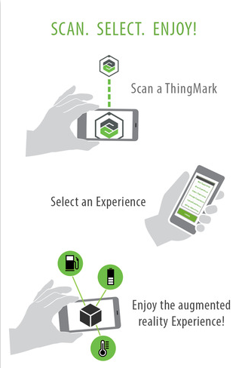
Free to download
Simple access via App stores
Window to Experience
Display contextualized content and 3D engineering data
Internet of Things
Display real-time IoT data on your mobile device
Many Experiences
One app enables the deployment of all experiences

Slide 21
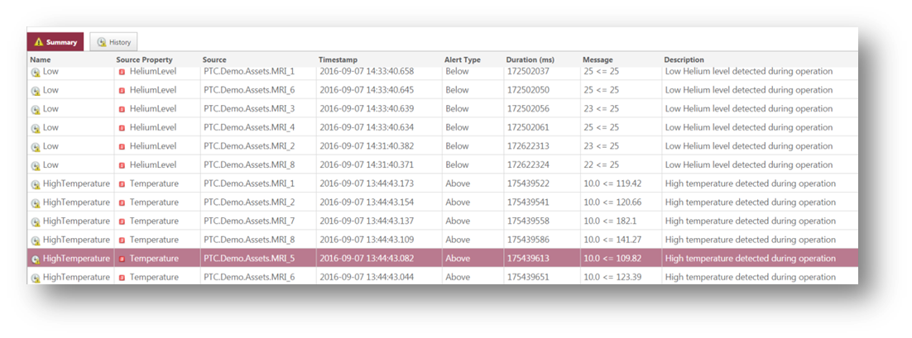
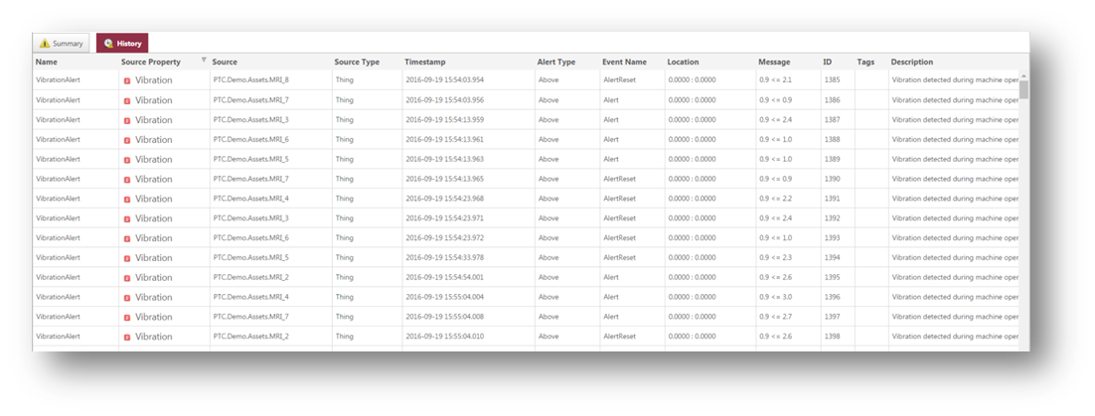
ALERT management Features
Real-time alert dashboard
Historic alert summary
Sort and filter
Alert acknowledgement
Individual alert(s)
All alerts
Individual alert detail and history
Integration to Asset Management
Notes:
Provides a view of real-time alerts across all devices in a single interface
A similar view of historic alerts is also available
Users can sort and filter alerts on the dashboard by various criteria (e.g. ack, ackBy, ackTimestamp, alert type, description, duration, message, name, priority, source, sourceProperty, timestamp)
Alerts can be acknowledged individually or multiple at the same time
From the real-time dashboard, drill down on individual alerts to view the alert details (desc, alert type, message, timestamp, duration, source, property, ack, ack by, ack timestamp)
A link to Asset Management is also available to view asset information and further troubleshoot as needed

Slide 22
REAL TIME INTELLIGENT ANOMALY DETECTION
Monitors and learns from your Things in real time. Uses machine learning technology to learn, in real-time, what “normal” state is for every data stream or Thing that is monitored or “watched”.
Rules Free. Does not depend on pre-defined rules or configuration to understand normal and abnormal state for a Thing. Learns from observing the Thing itself, with artificial intelligence.
Easy to Integrate into Solutions. Simple to integrate the output of real time anomaly detection into a solution for developers to help users or systems to take action.
*ThingWatcher currently in BETA
Notes:
What is ThingWatcher? ThingWatcher is the real-time, edge analytics tool from ThingWorx Analytics. It is quickly deployed via the development process in ThingWorx Composer and learns in real-time about an individual data stream and/or environment.
Deployed on the edge of a network for real-time monitoring of individual data streams in an IoT ecosystem.
Learns in real-time what “normal” is for every data stream that it monitors.
Does not require rules, predefined models or configuration to begin learning about an object.
Alerts users as to when anomalies are detected via the ThingWorx-powered solution they use.
Simple to integrate into a solution for developers.

Slide 23
Industry 4.0 MATURITY STEP 4: TRANSPARENCY
Resources
Information Systems
4
Transparency
<<<<<
<
Organizational Structure
Culture

Slide 24
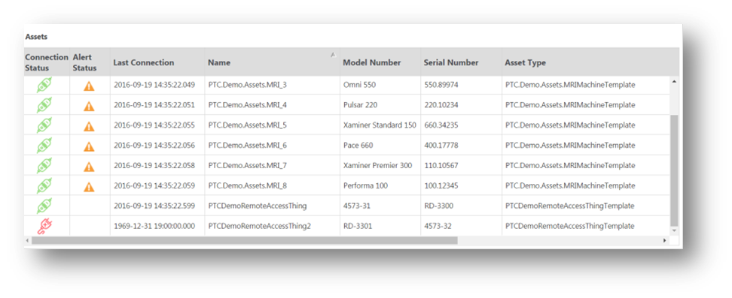
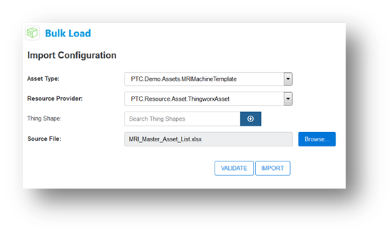
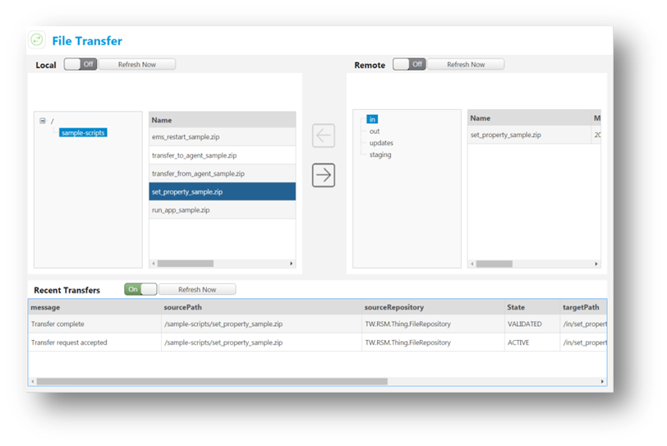
ASSET management Features
Asset overview
Asset create, edit, activate, deactivate
Asset bulk load (via API & user interface)
Configurable asset search
Dynamic asset filtering
Configurable table view
Saved Searches
Asset detail information
Properties
Real-time and historic alerts
Real-time and historic property values
Bi-directional file transfer (online & offline)
Secure remote connection
Configurable menu structure
Notes:
Overview of all assets in single view showing connectivity status (online/offline), does it have any alerts and property information like SN, model, asset type, owner, etc.
Ability to create, register and activate new assets in the system (provision), edit existing asset information and deactivate assets (note that activation and deactivation is done from the overview screen)
Bulk load assets via the backend API (e.g. something a developer can do) or user interface (business admin)
Configurable Asset search page where the business user can dynamically determine what properties they’d like to search for assets on, which fields display in the overview grid and easily save their searches for future use
View specific asset details such as static properties (e.g. SN, model, owner, operator, etc.) and location on a map
View alerts for a specific asset, both current and historic
View real-time and historical values for more dynamic properties (e.g. temp, pressure, vibration, etc.) on a graph
Transfer files to and from assets (e.g. pull log files to help troubleshoot an issue, push files to the device to fix)
File transfer works when the device is connected as well as when it’s not (if disconnected file queues and transfers when connected again)
Securely connect to devices using common remote access tools such as secure shell (SSH), remote desktop, VNC
All file transfers and remote connections are logged and available in audit trails for compliance
Ability to customize the utilities such as changing the branding (logo, utility name) and adding menu items (asset overview and asset details menu)

Slide 25
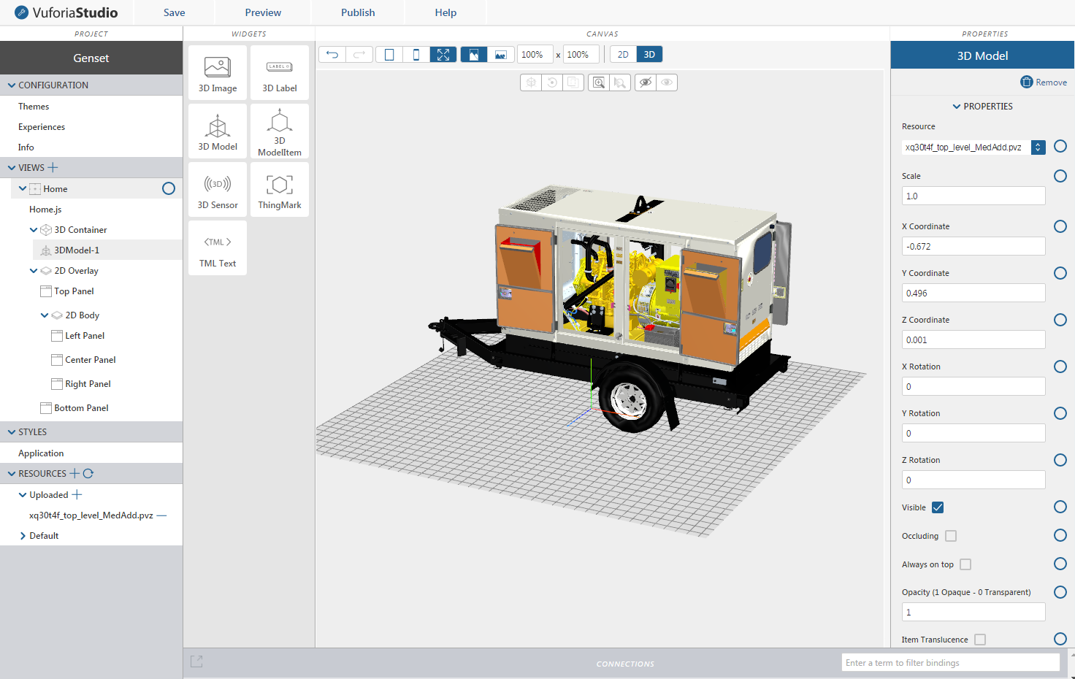
Create experiences
Built-in widgets accelerate experience design to add interactive UI components
Experience preview
Preview UX design prior to publishing
Simplified publishing
Publish your with a single click
CSS Editing
Create custom Experience styles
Extend with Javascript
Extend capabilities with embedded Javascript
Various 3D File
Format Support
Creo View .pvz, .step, .iges, .stl, .obj, .vrml & .dgn

Slide 26
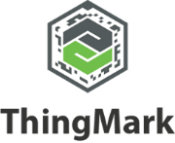
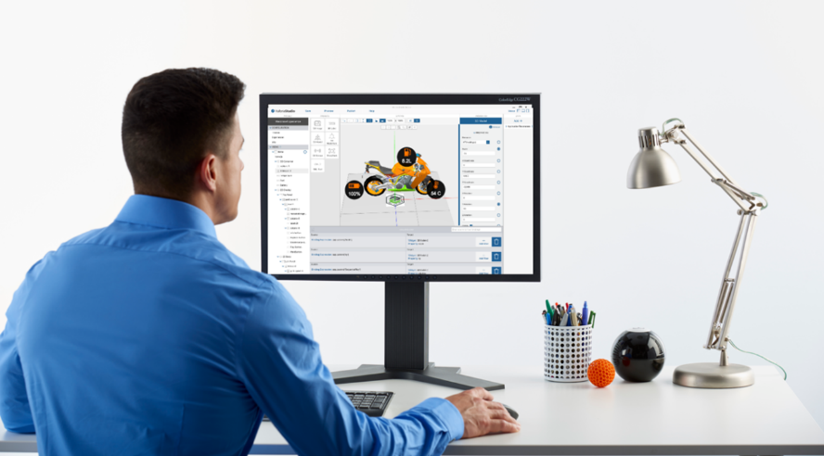
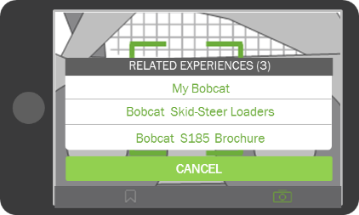
How it works
Publish Content
<Domain ID> + <Instance ID>
Pick your AR experience content

Slide 27
DEEP Intelligence Engine
Uses machine learning to automatically build and validate predictive models without assistance from a statistician, using data from your your Things data as a learning source.
Uses a patent-pending technology to explore various sophisticated predictive modeling algorithms to determine the best algorithm to use for each data set and predictive topic
Automated machine learning ready data preparation without ETL (when used with ThingWorx Composer)
Dramatically reduces or eliminates the need for an expert team in modeling algorithms or technologies
Automatically identifies and reveals which data signals are most important in predicting outcomes
These predictive models are instantly usable by ThingPredictor and ThingOptimizer to perform predictions, simulations and determine recommendations
Notes:
ThingWorx Analytics Server powers ThingPredictor and ThingOptimizer with automated model building, validation, operationalization and maintenance.
Automates complex analytical tasks like predictive modeling and simulations.
Uses advanced artificial intelligence and machine learning to automatically build, maintain and operationalize advanced analytical models.
Powers ThingPredictor and ThingOptimizere with automated predictions, simulations and recommendations within ThingWorx-powered solutions.
Can be deployed in the cloud or within a data center.
Requires ThingWorx Analytics Server to perform prescriptive and/or causal factor scoring

Slide 28
Industry 4.0 MATURITY STEP 5: PREDICTABILITY
Resources
Information Systems
5
Predictability
<<<<<
<
Organizational Structure
Culture

Slide 29
Automated Predictive insights
Automatically build and validate predictive models without assistance from a statistician, using your Thing data as a learning source
Subscribe your “things” to one or more predicted outcomes (time to failure, future efficiency, etc.)
Real time or batch predictions (“scoring”)
Uses prediction models generated by ThingWorx Analytics Server or equivalent PMML-compliant prediction model generation tool
Notes:
What is ThingPredictor? ThingPredictor is a tool that enables develoeprs to subscribe their things to one or more predicted outcomes for inclusion in a ThingWorx-powered solution.
Subscribe your “things” to one or more predicted outcomes (time to failure, future efficiency, etc.)
Real time or batch prediction scoring.
Runs on-premise or in the cloud.
Learns to predict from the historical data of an object.
Requires ThingWorx Analytics Server or equivalent PMML-compliant prediction model generation tool to run.

Slide 30
Industry 4.0 MATURITY STEP 6: ADAPTABILITY
Resources
Information Systems
6
Adaptability
<<<<<
<
Organizational Structure
Culture

Slide 31
Optimize future outcomes
Perform ad-hoc outcome simulations before you take an action
Identify casual and key contributing factors associated with predicted outcomes
Identify optimal settings to maximize or minimize the risk of an outcome
Uses prediction models generated by ThingWorx Analytics Server or equivalent PMML-compliant prediction model generation tool
Notes:
What is Optimizer? ThingOptimizer is a tool that can be embedded within a ThingWorx-powered solution that delivers simulations and recommendations to end users without having to manually build or maintain models.
Perform ad-hoc outcome simulations before you take an action.
Identify casual and key contributing factors associated with predicted outcomes.
Identify optimal settings to maximize or minimize the risk of an outcome.
Requires ThingWorx Analytics Server to perform prescriptive and/or causal factor scoring

Slide 32
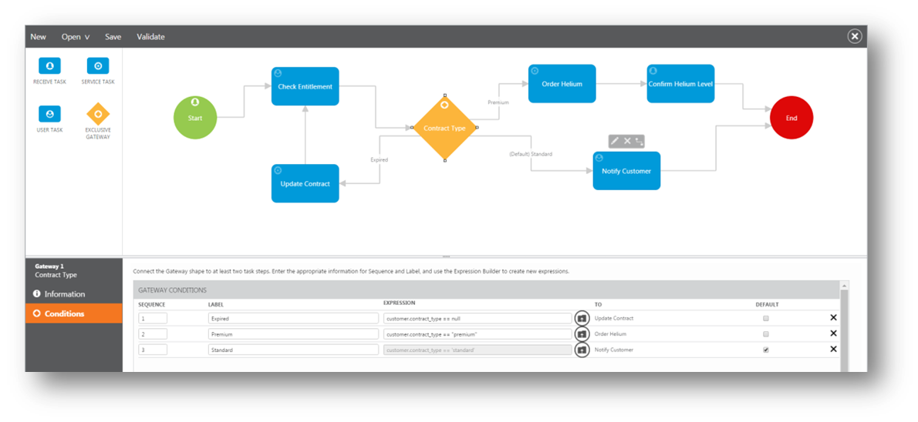
Workflow builder
Drag and drop interface
Workflow create, edit, activate, deactivate
Multi-step workflows
Multiple task types
Decision support logic with branching
Associate alerts and services to tasks
Workflow validation
Notes:
Visio-like interface to build workflows, simple drag and drop the tasks (shapes) onto the canvas and connect them
Ability to create new workflows, open/edit existing workflows and activate/deactivate workflows (a workflow may be created and exist in the tool, but inactive meaning it won’t be started with the alert is triggered)
Workflows are generally composed of multiple steps or tasks, these include activities and decision points (gateway, branching, the diamond shape)
There are several task types: receive task (e.g. define the event/alert from a connected device), service task (execute a service to perform some action), user task (points to a mashup where user can interact / intervene with process)
Ability to include decision support logic in workflows including:
Human intervention (e.g. user clicks button on a mashup that advances the workflow)
Rules (e.g. if low priority, just send notification; if higher priority open case in CRM; if highest priority, sched a field tech)
Web services (e.g. interact with another system)
Associate alerts and services to tasks (e.g. what event or alert initiates a workflow, what services get executed at each step)
Workflow validation: Tasks are validated to contain appropriate associations with events, mashups or services.
The Workflow Builder provides an integrated environment for creating, editing, and managing workflows triggered by pre-defined alerts associated with information streamed from and or related to smart, connected devices. Designed for use by business users rather than developers, the Builder enables the initiation of workflows across multiple systems that can be composed of one or more steps with decision support rules.

Slide 33
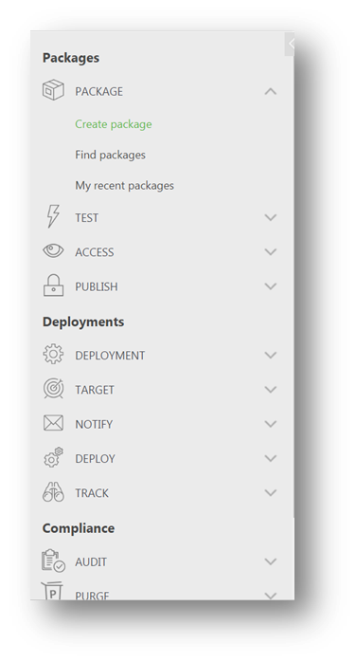
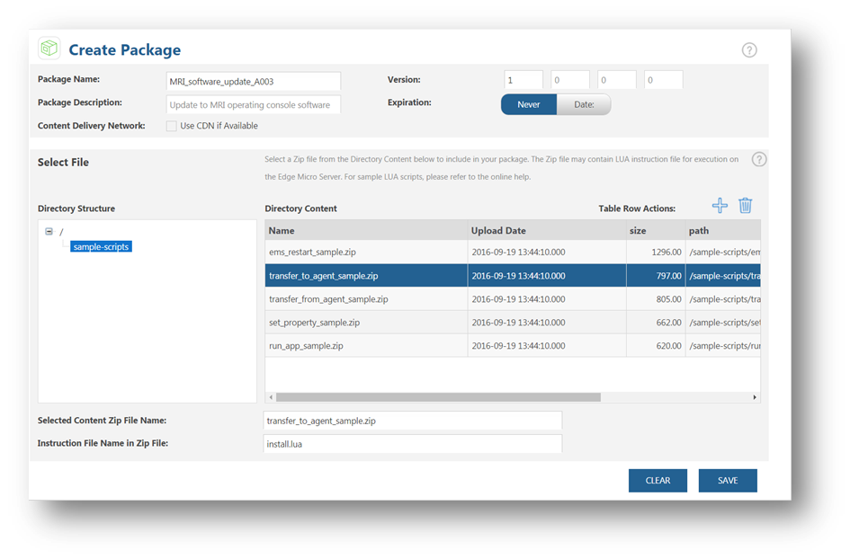
Software Content Management Features
Content package and deployment dashboard
Package and deployment configuration
Package and deployment testing
Deployment scheduling
Status tracking and audit trail
Deployment purge
Content management APIs
Integration with AWS CloudFront CDN
Notes:
Convenient package and deployment dashboard showing status of your packages, all packages, current deployment status and historical deployments
Configure packages (create package by uploading content, version it, set expiration if any, define instruction file to execute) and deployments (define package to deploy, target assets to deploy to, select users to notify)
Test packages and deployments in the utility before actually publishing (actually deploy package to some assets in a QA or test environment
Ability to set package download and installation times either immediately or schedule for some date / time in future
All deployments are tracked and status can be viewed by package or asset, as well as, in an audit trail for compliance
Ability to purge past deployments by various criteria (deployment name, description, package, date, etc.)
We exposed APIs that let developers configure custom processes for distributing software to connected devices, with the flexibility to incorporate external systems. For example, the customer may have existing tools and systems they create the packages in and just want to automatically send those to SCM to manage the deployments and audit delivery
Finally, we are adding or have added (targeted for Dec 2016) integration with leading Content Delivery Network or CDN providers to support large scale deployment of software. Initially targeting Amazon Cloudfront, but goal is to make it configurable enough to support any CDN (e.g. Akamai is another)
ThingWorx Software Content Management provides the tools that allow you to create, manage, test, and deploy packages, either for immediate deployment or at a scheduled time in the future. Target devices can be determined based on filtering of assets, and testing of both packages and deployments before making them available in production. Search and auditing tools are provided allowing you to track and record the distribution status.
You can track all package activities throughout the distribution and deployment process to ensure that all tasks are completed as specified. Viewing the status of an individual connected device gives real-time visibility to current revision level and one-time deployments can be pushed by a support engineer to a device at a specified time or immediately.
Additional features include:
• User Authentication – Specify who has authorization to create and use a package. Packages in progress do not become available to the public until the creator publishes them.
• End-User Authority – Allow end users to refuse uploads and downloads to one or more devices with end-user permissions.
• Audit Trail – Track the package creation and deployment processes by viewing real-time and historic information at any time. Every action and cause is written to an audit log, ensuring security and satisfying reporting, training, business improvement, regulatory, and non-repudiation requirements.
Content Management APIs enable developers to configure custom processes, with the flexibility to incorporate separate systems, for distributing software to connected devices. API support includes Create / publish package, Create / start deployment, Monitor / audit delivery (10 APIs in total)
Best practices based on Axeda and ThingWorx experience

